Slide 1

MTA (Master Tracking Application) Supplier User Manual
EFU, Prenotice & Packing List
2017 - April
© 2016 General Electric Company. Proprietary. All Rights Reserved.

Slide 2

TABLE OF CONTENTS 目录
MTA Login - MTA登录
Page 3
EFU List Generation - 创建EFU
Page 7
Prenotice & Packing list Generation - 创建预通知及箱单
Page 15
Packing List Management - 箱单管理
Page 24
© 2016 General Electric Company. Proprietary. All Rights Reserved.

Slide 3
MTA Login - 登录MTA
MTA Supplier Login page:
登录网址如下：
https://mtaportal.gepower.com/
注意：该网址登陆没有内网限制，普通外网即可登陆
© 2016 General Electric Company. Proprietary. All Rights Reserved.

Slide 4
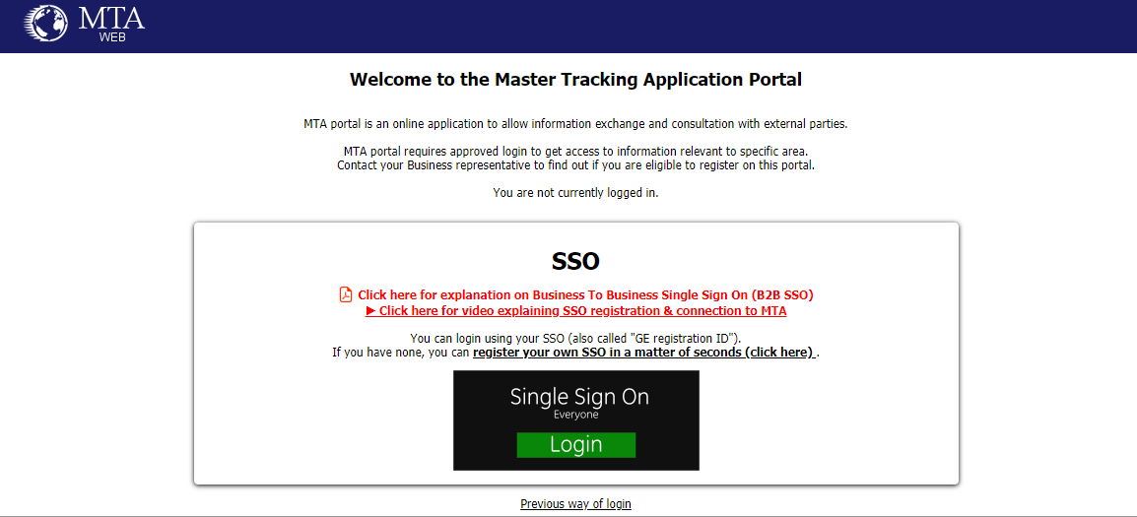
MTA Login - 登录MTA
此处注册SSO
注册后在此处登陆SSO
© 2016 General Electric Company. Proprietary. All Rights Reserved.

Slide 5
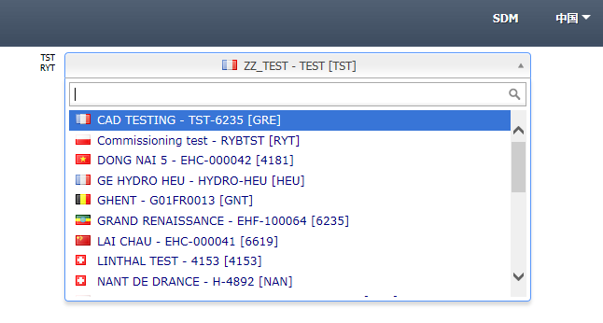
MTA Login - 登录MTA
Select the target Project name to proceed operations.
选择项目：在Project（项目）中选择要进行操作的项目。
© 2016 General Electric Company. Proprietary. All Rights Reserved.

Slide 6
TABLE OF CONTENTS 目录
MTA Login - MTA登录
Page 3
EFU List Generation - 创建EFU
Page 7
Prenotice & Packing list Generation - 创建预通知及箱单
Page 15
Packing List Management - 箱单管理
Page 24
© 2016 General Electric Company. Proprietary. All Rights Reserved.

Slide 7
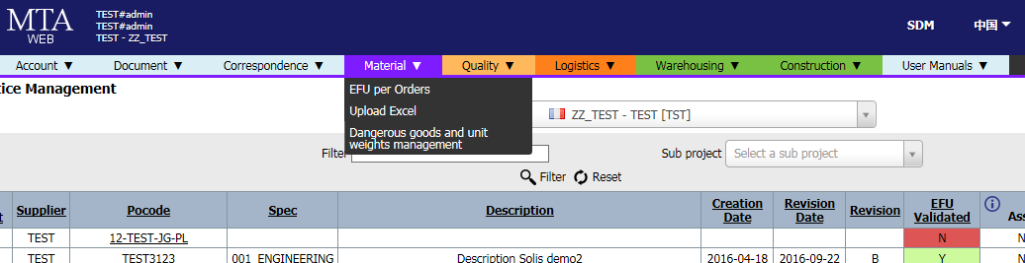
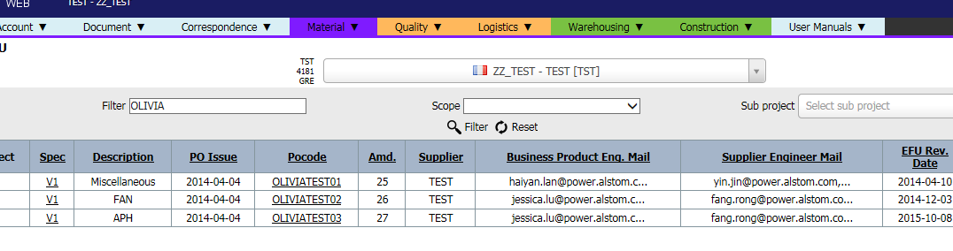
EFU List Generation - 创建EFU (EFU = Equipment Follow-up)
Step 1：
Click “Material” Menu, then Click “EFU per Orders”
点击“Material”下拉框中的”EFU per Orders”
Step 2：
Input PO number in Filter bar then Click “Filter” or Press enter key
在“Filter” 搜索框内输入
相应订单号并按下回车键
© 2016 General Electric Company. Proprietary. All Rights Reserved.

Slide 8
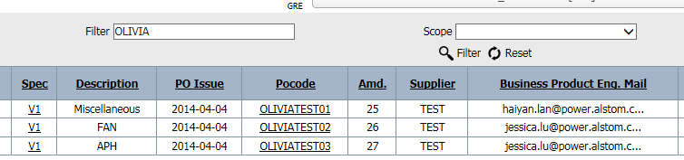
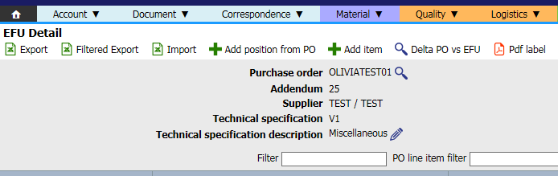
EFU List Generation - 创建EFU
Step 3：
Click PO number which you want to generate EFU list
点击PO号，进入对应的EFU创建界面：
Step 4：
Click Export icon to download Excel template
点击“EXPORT” 图标导出EFU模板表格
© 2016 General Electric Company. Proprietary. All Rights Reserved.

Slide 9
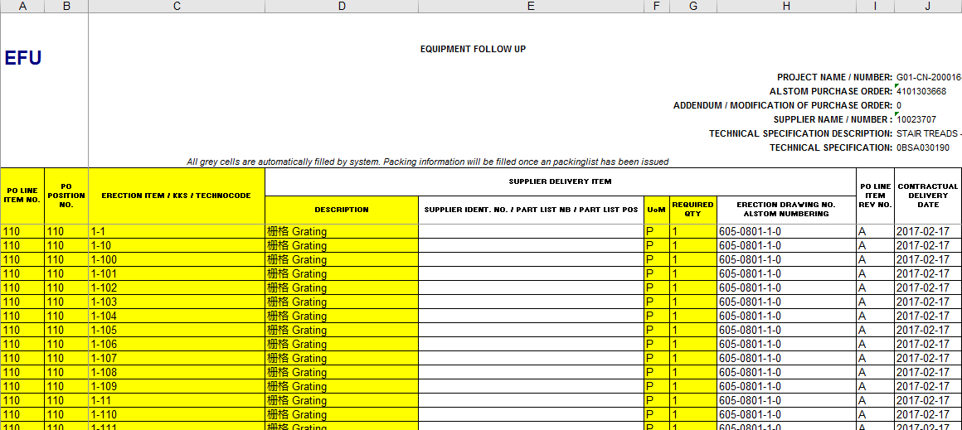
EFU List Generation - 创建EFU
Step 5：
Input the necessary EFU information on the Excel table, then save the file
在导出的EFU模板表格中，填写相关的EFU信息，然后保存文件
Tips: Yellow parts are mandatory required
DO NOT modify Grey parts
注意：其中黄色标记的部分为必填项，灰色标记部分的信息不能修改，否则可能导致表格无法上传
A
B
C
D
F
G
© 2016 General Electric Company. Proprietary. All Rights Reserved.

Slide 10
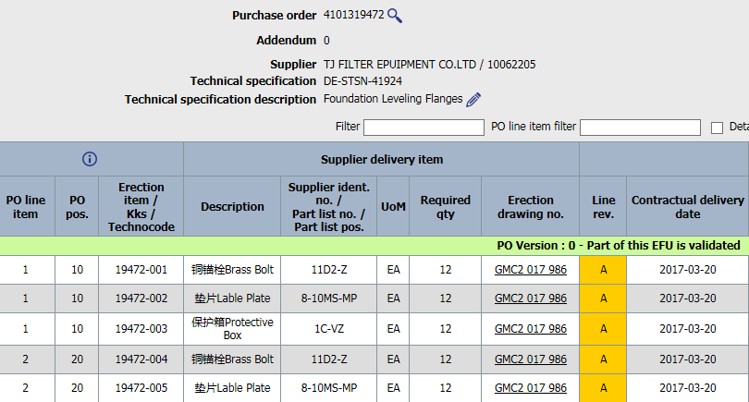
EFU List Generation - 创建EFU
Tips of EFU list input:
填写EFU列表时，须注意如下几点：
I. Using original “PO line item” & “PO position numbers” for each PO line’s EFU raw.
PO Line的编号，须与PO Position的对应关系应保持一致
II. Erection item/Techni code should be Unique
(May need to confirm the numbering rules with BU*)
货物的物料号“Erection item/Techni code”必须
是唯一的（可能需要与BU*确认编号规则）
*BU means related Engineer or Logistics team
*BU是指相应的工程师或者物流团队
© 2016 General Electric Company. Proprietary. All Rights Reserved.

Slide 11
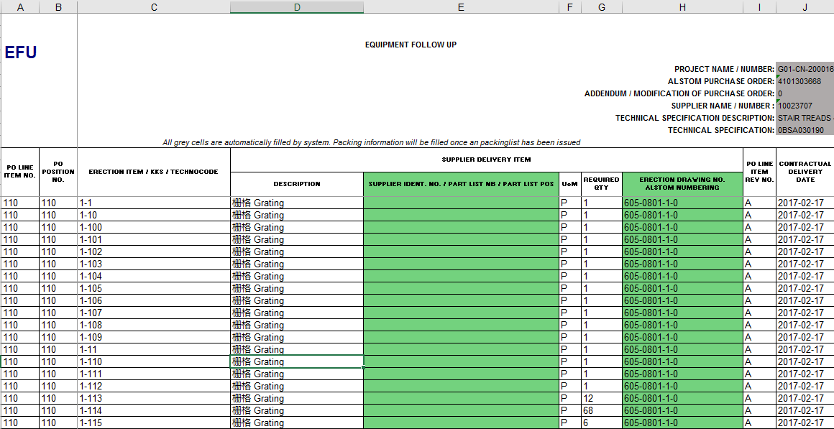
EFU List Generation - 创建EFU
III . For the Green parts, please check with BU whether they have any requirement to input.
(Not a mandatory required part of MTA system.)
图中绿色部分虽然为选填部分，但仍需与BU确认是否有输入的需求以及输入的标准
IV. Please remove the initial line(s) on template. 在填写完成EFU list之后，请删除模板中的原始行。
V. 如需填写中文描述，请将中文描述写在英文描述之前
E
H
© 2016 General Electric Company. Proprietary. All Rights Reserved.

Slide 12
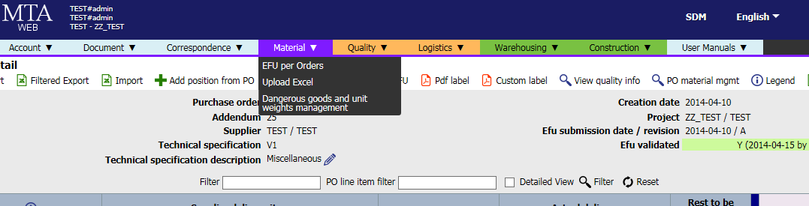
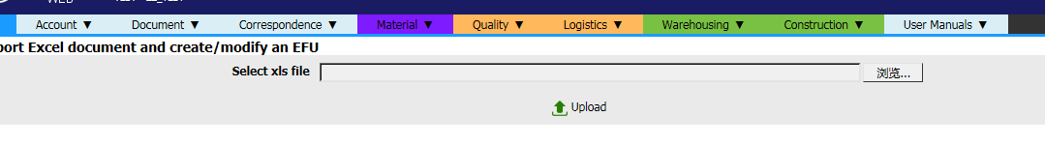
EFU List Generation - 创建EFU EFU List Upload – EFU表格上传
Step 6: After save the Excel file, Click “Upload Excel” under “Material” menu
完成表格填写后，点击“Material”下拉框中的 “Upload Excel” 选项
Step 7: Click “Browse” button to find the EFU file in your computer, then Click Upload
点击“浏览”找到文件，然后点击“Upload”，完成EFU表格上传
1
2
© 2016 General Electric Company. Proprietary. All Rights Reserved.

Slide 13
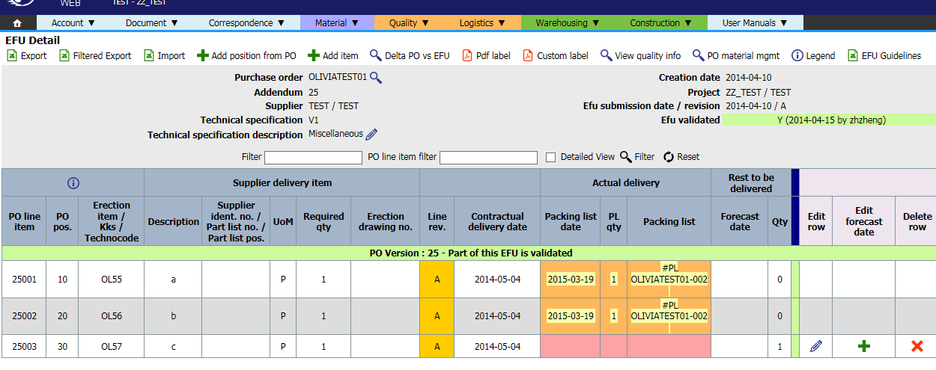
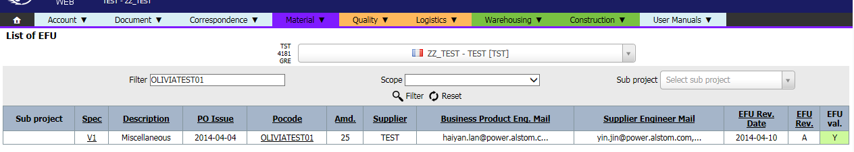
EFU List Generation - 创建EFU EFU Validation – EFU 确认
You can check EFU list via search PO number at anytime after uploaded, Click PO number to check details
完成上传后，可通过查询PO号查看EFU信息, 点击PO号可查看详情
Engineer will valid the EFU list, after that, “EFU val. “column will turn to green with letter “Y”
经工程师确认EFU信息，审核通过后的“EFU val.”列会变成绿色并显示“Y”字样
© 2016 General Electric Company. Proprietary. All Rights Reserved.

Slide 14
TABLE OF CONTENTS 目录
MTA Login - MTA登录
Page 3
EFU List Generation - 创建EFU
Page 7
Prenotice & Packing list Generation - 创建预通知及箱单
Page 15
Packing List Management - 箱单管理
Page 24
© 2016 General Electric Company. Proprietary. All Rights Reserved.

Slide 15
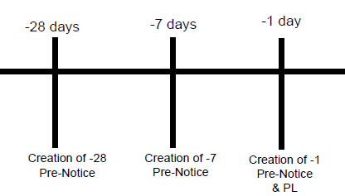
Prenotice & Packing list Generation – 创建预通知及箱单
There are three Prenotices required before delivery. Prenotice contains Quantity of Packages, Package Methods, Volumes, Weights, Where and When they can be picked up.
在正式发货之前，供应商须在系统内提交三次预通知告知GE即将发货；预通知包含运输信息（包装数量，包装方式，体积，重量，交货时间和地点）。
The first Prenotice should at 28 days before PO delivery date
第一次通知在合同交货期之前的第28天；
The second Prenotice should at 7 days before PO delivery date
第二次通知在合同交货期之前的第7天；
The third Prenotice should at 1 day before PO delivery date
第三次通知在合同交货期之前的第1天。
© 2016 General Electric Company. Proprietary. All Rights Reserved.

Slide 16
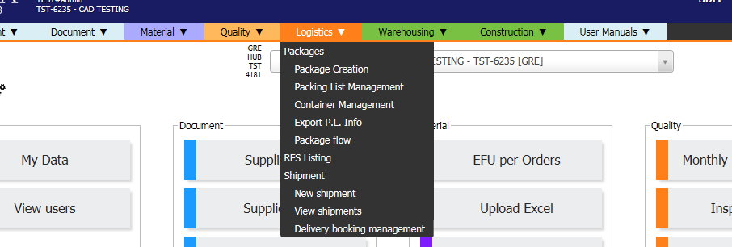
Prenotice & Packing list Generation – 创建预通知及箱单
Step 1： Click “Logistics” menu then choose “Prenotice/Package Creation”
点击 “Logistics” 下拉菜单栏中的 “Prenotice/Package Creation”进行创建
© 2016 General Electric Company. Proprietary. All Rights Reserved.

Slide 17
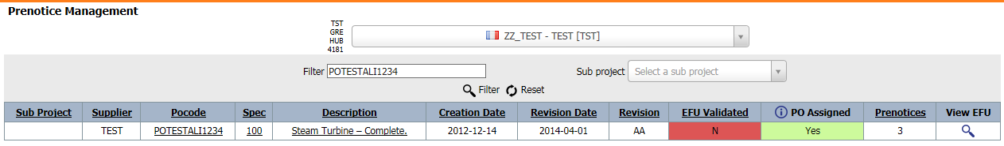
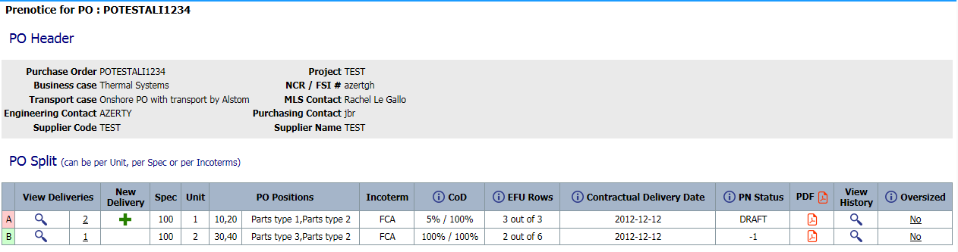
Prenotice & Packing list Generation – 创建预通知及箱单
Step 2： Search related PO number, click the correct line
查询、点击对应的PO号，可进入PO并创建预通知；
Step 3： Click green cross sign to generate new Prenotice
点击绿色加号进行添加；
1
2
© 2016 General Electric Company. Proprietary. All Rights Reserved.

Slide 18
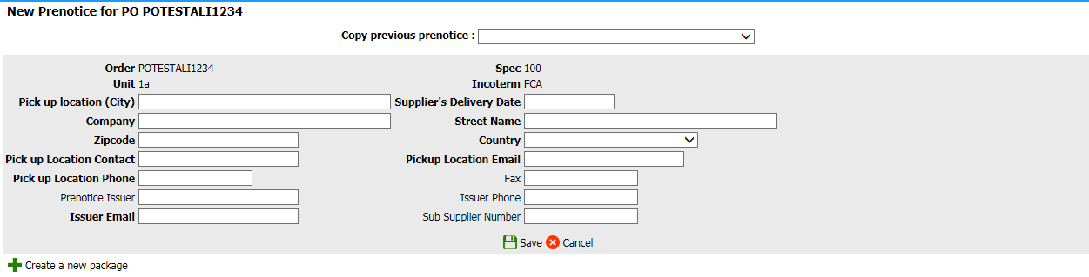
Prenotice & Packing list Generation – 创建预通知及箱单
Step 4：Fill full the necessary parts (font bold parts), then Click “Create a new package” to add package(s) under this Prenotice. One Prenotice at least need contains one Package.
填写预通知信息，其中粗体部分为必填项，填写完成后点击“Create a new package” 在预通知下添加包裹，预通知下至少要有一个包裹。
1
2
© 2016 General Electric Company. Proprietary. All Rights Reserved.

Slide 19
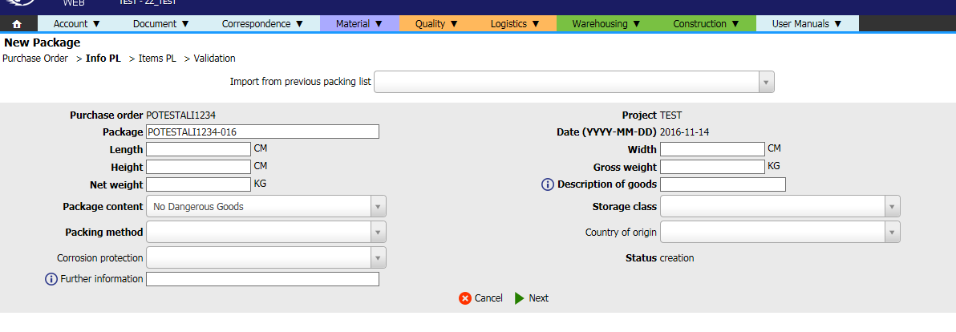
Prenotice & Packing list Generation – 创建预通知及箱单
Step 5：Fill full the necessary parts (font bold parts), then click “Next” to proceed
Package numbering rule please check with each BU
填写完详细信息后（粗体字部分为必填），点击“Next”继续
箱单号的命名规则请与订单相关的BU确认
1
2
© 2016 General Electric Company. Proprietary. All Rights Reserved.

Slide 20
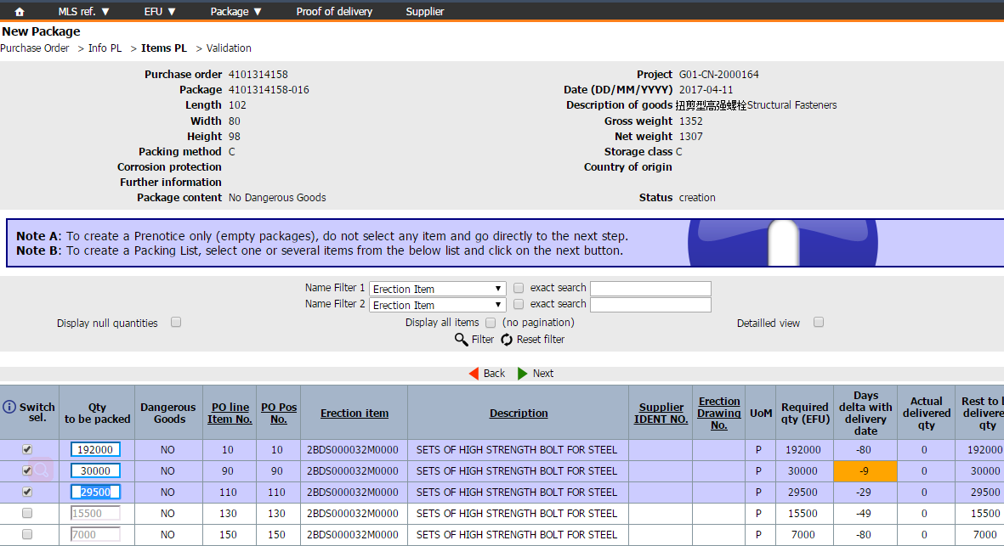
Prenotice & Packing list Generation – 创建预通知及箱单
Step 6：To create a new packing list, select the EFU materials with correct quantity, then click “Next”
If want to generate a Prenotice only, click “Next” without select any EFU materials
若要创建一个新的箱单，在列表的中选择一项或几项物料，并确认数量，点击“Next”；若只创建一个预通知（空包装），不选择任何物料项（即不需要勾选添加任何EFU），直接进入下一步
1
2
© 2016 General Electric Company. Proprietary. All Rights Reserved.

Slide 21
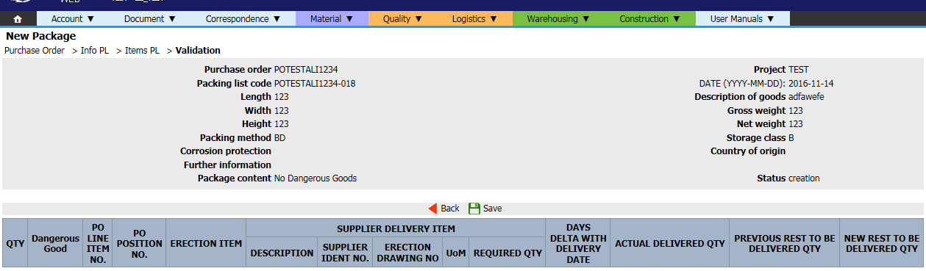
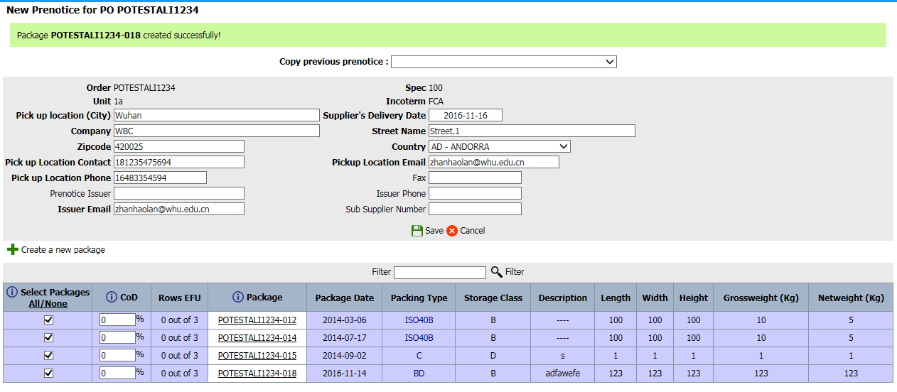
Prenotice & Packing list Generation – 创建预通知及箱单
Step 7：Check package information and click “Save”
Repeat Step 4-7 to add more packages
确认包裹信息并点击“Save”
重复步骤4-7以添加更多的包裹
Step 8：Check Prenotice information, input percentage value (%CoD) of each package and click “Save”
If it’s an empty package, input 0.01% on %CoD to let Prenotice able to be saved.
确认预通知以及包裹数量，填写每个包裹占整个批次总货值的百分比并点击“Save”，如果录入的是空包裹，请在%CoD处输入 0.01%使预通知可以保存。
2
1
© 2016 General Electric Company. Proprietary. All Rights Reserved.

Slide 22
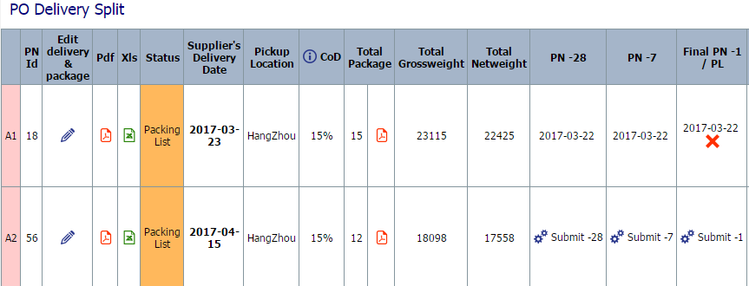
Prenotice & Packing list Generation – 创建预通知及箱单
Click “Submit -28”, “Submit -7” or “Submit -1” button to trigger related Prenotice to GE
点击 “Submit -28”, “Submit -7” 或 “Submit -1” 来发送28天、7天、1天预通知至GE
Tips：After click “Submit -1” button, supplier will not able to do any modification on this Prenotice & Packing list
注意：-1天预报提交前，请确保所有的信息准确无误，供应商提交-1天预报后，箱单信息将无法更改
After all process, if still need do some modifications, contact MLS to reject the -1 day prenotice to do further modifications.
如果完成了所有操作之后仍需修改信息，请联系MLS退回-1天的预通知进行更改操作。
© 2016 General Electric Company. Proprietary. All Rights Reserved.

Slide 23
TABLE OF CONTENTS 目录
MTA Login - MTA登录
Page 3
EFU List Generation - 创建EFU
Page 7
Prenotice & Packing list Generation - 创建预通知及箱单
Page 15
Packing List Management - 箱单管理
Page 24
© 2016 General Electric Company. Proprietary. All Rights Reserved.

Slide 24
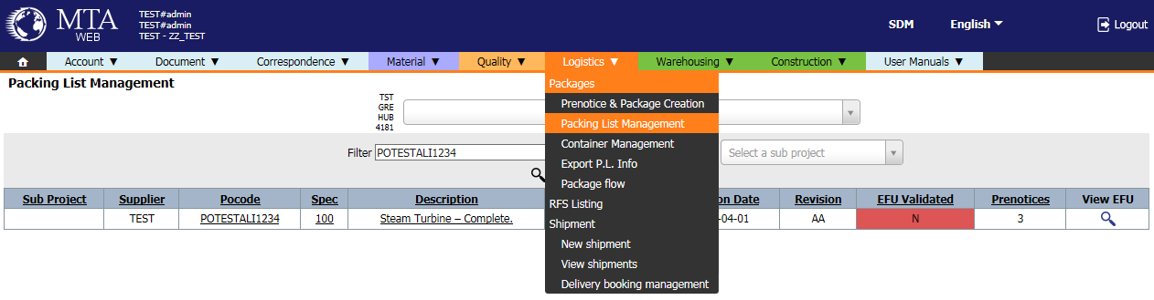
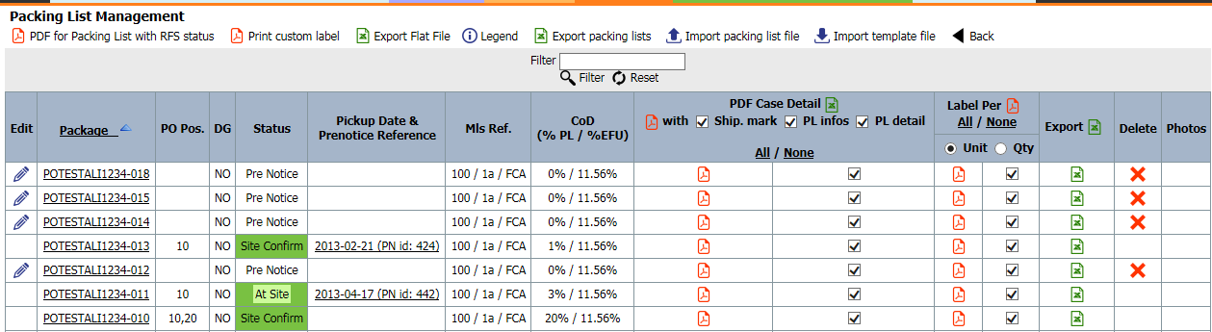
Packing list Management – 箱单管理
Click “Logistics” menu, choose “Packing List Management”
点击“Packing List Management”
Search via PO number, click related PO
Tick lines and click PDF icon to output packing list and label
勾选所需要的行，点击PDF图标导出箱单与标签
© 2016 General Electric Company. Proprietary. All Rights Reserved.

Slide 25
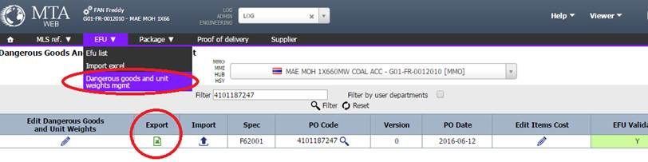
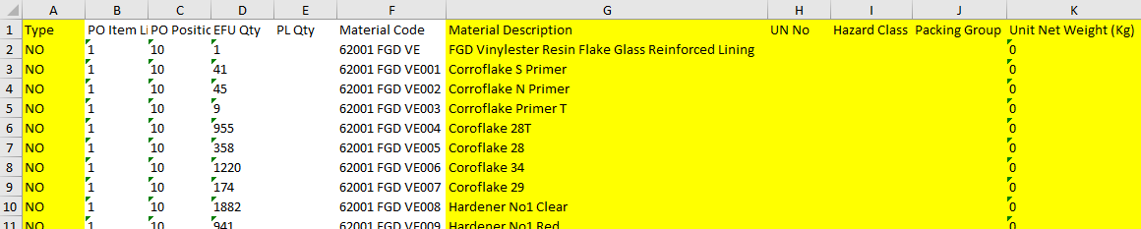
To register the Dangerous Goods in MTA – 在MTA上登记货物中的危险品
Go to EFU Menu and click “Dangerous goods and unit weights mgmt”.
在EFU菜单下点击“Dangerous goods and unit weights mgmt”.
The EXCEL file exported as left. (Detailed introduction on the next page.)
导出如左图的EXCEL文件（具体填写要求见后页）

Slide 26
To register the Dangerous Goods in MTA – 在MTA上登记货物中的危险品
Column A “Type”:
NO = No Dangerous Goods, CP = Chemical Product, DG = Dangerous Goods
A列类型，NO为非危险品，CP为化学制品，DG为危险品
Column G “Material Description”:
When an item is defined as DG, the same description as the MSDS must appear in this list.
G列产品描述，如果产品是危险品，则产品描述必须和MSDS中的品名一致
Column H, I, J, K:
When an item is defined as DG, the UN Number, Hazard Class, Packing Group & the Weight per Unit must be provided.
当一个产品被标为危险品时，H,I,J,K列的“UN Number, Hazard Class, Packing Group & the Weight per Unit” 这些信息必须填写
Column L, M:
Country of Origin & HS Code, fill when required by SPMI (Shipping Packing and Marking Instructions)
如SPMI有要求，则L,M列的原产国和HS CODE也需要填写
Save and Import (upload) the DG form after fill full the information.
表格填完后请在原页面上传
Select Dangerous Goods during package creation.
在新建箱单时勾选上Dangerous Goods选项

Slide 27
Thank You !
© 2016 General Electric Company. Proprietary. All Rights Reserved.

